Slide 1
WELCOME TO MICROBIOLOGY DEPARTMENT
Dr Hazel Tumelo Mufhandu
Deputy Subject Group Leader
Mahikeng Campus
Hazel.Mufhandu@nwu.ac.za

Slide 2
Faculty rules
Application, selection and admission
Module credit recognition & transfer
Exemptions from practicals/classes
Assessments, module marks, module requirements
Examination opportunities
Access to and review marks
Maximum duration, extension and termination of study
Readmission
Withdrawal of qualification

Slide 3
PROGRAMME: BACHELOR OF SCIENCE IN BIOLOGICAL SCIENCES
Programme: Bachelor of Science in Biological Sciences with MICROBIOLOGY AND BIOCHEMISTRY
Programme: Bachelor of Science in Biological Sciences with MICROBIOLOGY AND BOTANY
Programme: Bachelor of Science in ENVIRONMENTAL SCIENCES with MICROBIOLOGY AND CHEMISTRY

Slide 7
MODULES
NCHE111 - Introductory Inorganic and Physical Chemistry
NCHE121 - Introductory Organic Chemistry

Slide 9
Total Microbiology Modules = 108 Credits

Slide 10
MICROBIOLOGY MODULES - MC
1ST Year | 2nd Year | 3rd Year
MKBN121 (2nd Semester) | MKBN211 (1st Semester) | MKBS316 (1st Semester)
NCHE111 (1st Semester) Pre-requisite | MKBS221 (2nd Semester) | MKBS317 (1st Semester)
NCHE121 (2nd Semester) Pre-requisite |  | MKBS326 (2nd Semester)
 |  | MKBS327 (2nd Semester)

Slide 13
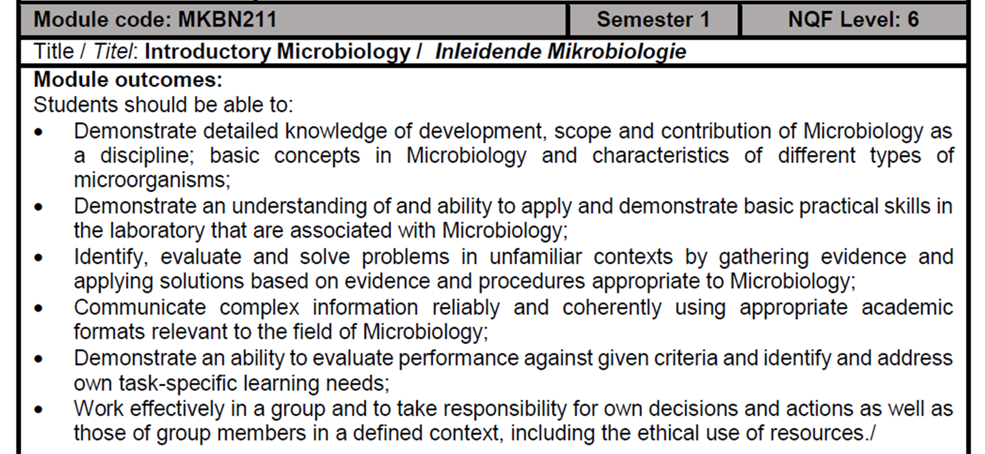
MODULE OUTCOMES

Slide 24
BEST WISHES
FOR 2021

